Slide 1
Setting – up network topology using two routers employing static routing

Slide 2
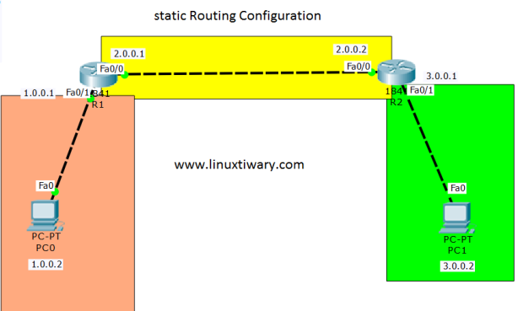

Slide 3
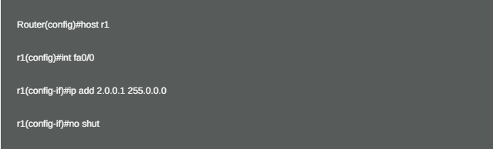
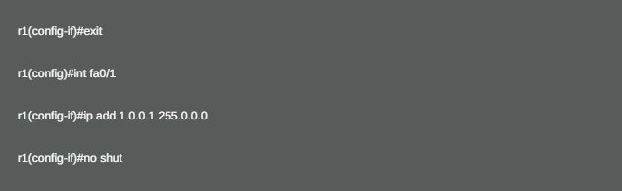
Assign IP address on Router R1:

Slide 4
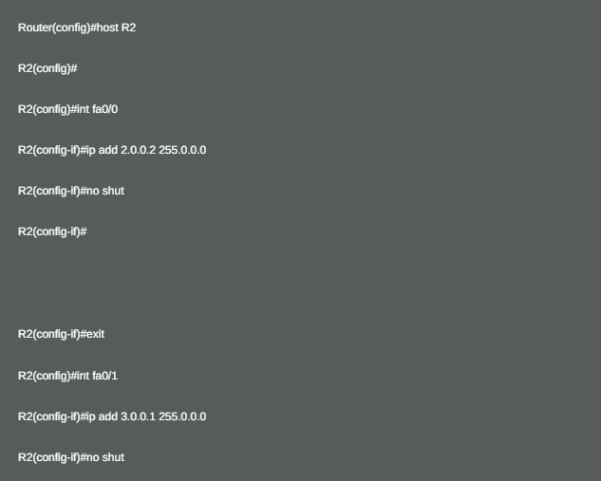
Assign IP address on Router R2:

Slide 5
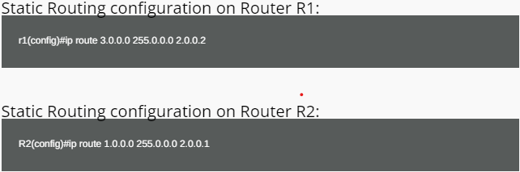
Static Routing configuration: In static Routing we don’t need to tell the Routers about Directly Connected Networks. But you have to tell the Routers about Indirectly Connected Networks. router(config)#ip route <indirectly connected network> <Netmask> <gateway IP to reach that network>

